Slide 1
205SE Programming for Engineers
Version Control System
How to use GitHub with Visual Studio
Chris Bass

Slide 2
Login to GitHub
Head over to our GitHub host:
https://github.coventry.ac.uk/205SE-1617OCTJAN
Replace 1617OCTJAN with our cohort number e.g. 1718OCTJAN
Sign in to GitHub with your University Username and Password

Slide 3
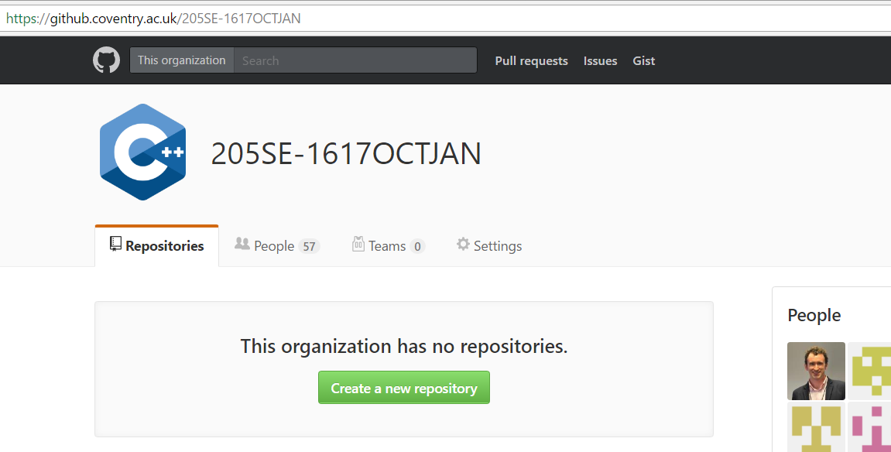
Create a New Remote Repository on GitHub
Click create a new repository.

Slide 4
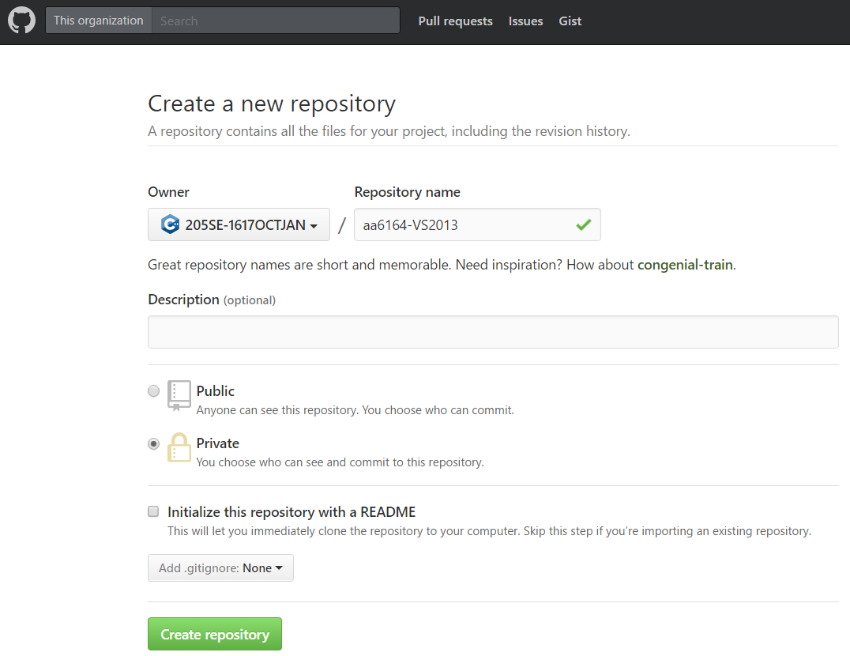
Choose a repository name e.g. <username>-<projectname>
Choose private.
Click create repository.

Slide 5
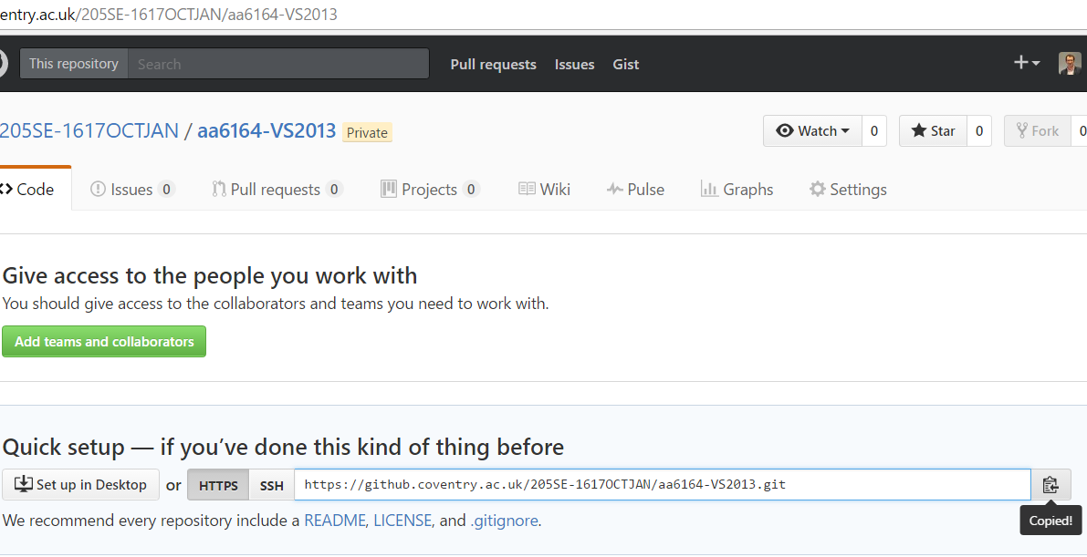
Copy the Remote Repository URL
Copy URL.

Slide 6
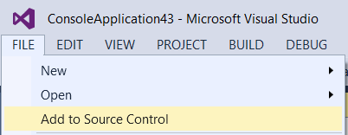
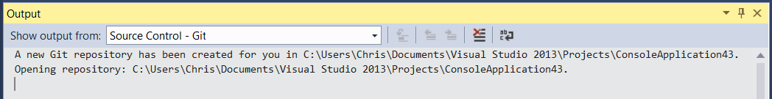
In Visual Studio Create a Local Git Repository
In Visual Studio:
If you already have a code project open which you would like to add to Git select:
File → Add to Source Control
This will generate a Local Git Repository
Now you will be able to see a .git folder and a .gitignore file in your project folder via Windows Explorer

Slide 7
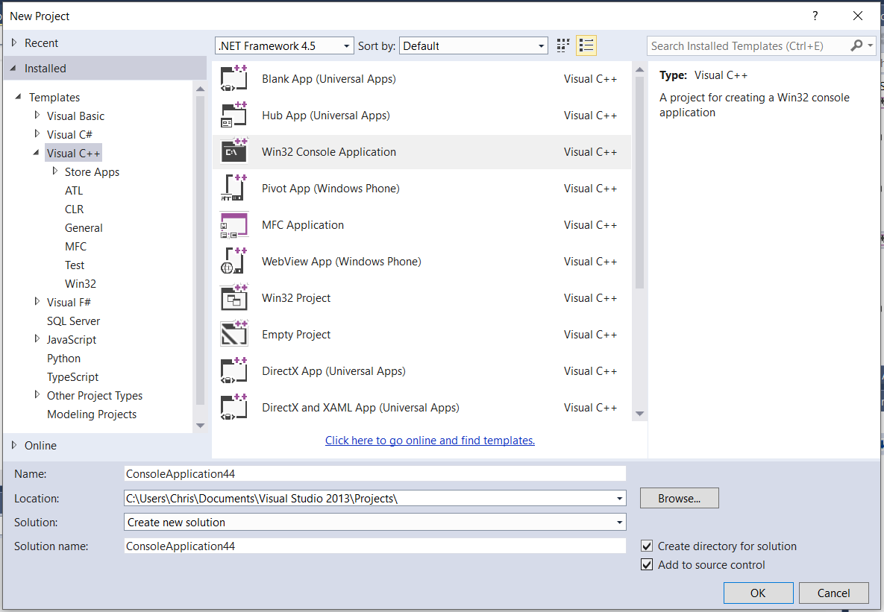
If creating a new project from scratch in Visual Studio, you have the option to “Add to Source Control” which also creates a Local Git Repository.

Slide 8
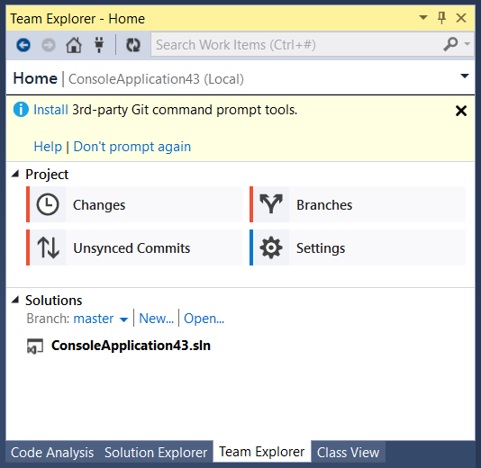
Team Explorer
In Visual Studio → Next to the ‘Solution Explorer’ tab → click the ‘Team Explorer’ tab.
Team Explorer is used to:
Make Commits to Local Repository (Local Changes).
Push to Remote Repository (Sync Commits).
Pull from Remote Repository (Sync).
Work on Braches.
Team Explorer tab.

Slide 9
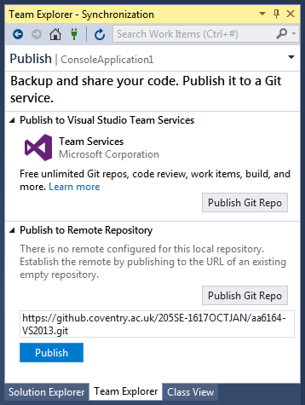
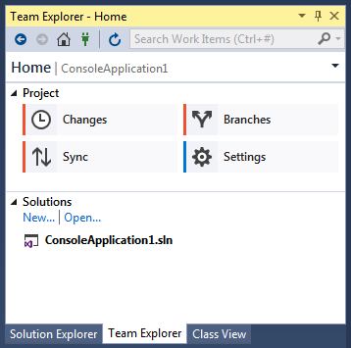
Linking Local Git Repository with Remote Repository on GitHub
In Visual Studio → Team Explorer → Select Sync.
Then paste the Remote Repository URL which we copied from GitHub earlier.
And “Publish to Remote Repository”.
Paste URL and Click Publish.

Slide 10
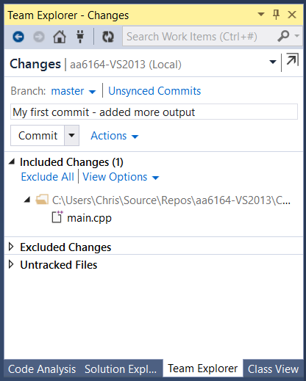
Add to/Edit your Source Code then Commit to Local Repository
First make changes to your source code.
Then in Team Explorer → click Changes → Commit.
Type a comment to describe your Commit e.g. new feature added or bug fixed and click Commit button.
Made changes to source code in main.cpp

Slide 11
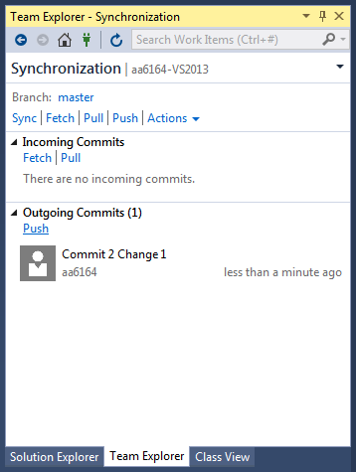
Push Local Commits to Remote Repository
Once you have used Commit to make changes locally, next we want to push those changes to the Remote Repository on GitHub.
Use Sync → Push to push your commit changes to the GitHub Repository.
Push outgoing commits.

Slide 12
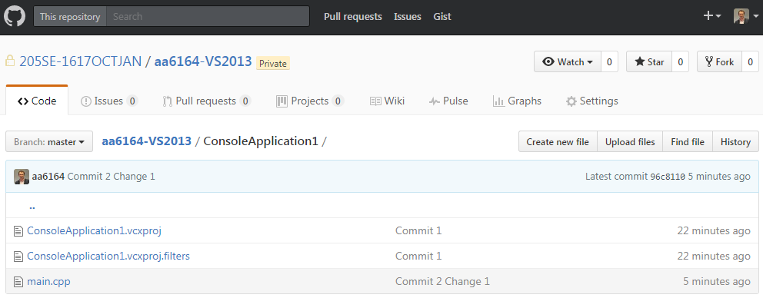
Changes have now been made to your Remote GitHub Repository…
Changes made

Slide 13
Working with more than one Project as part of a Solution in Visual Studio
If you already have a Visual Studio Solution with one Project in it, you can add additional new Projects to the same Solution by Right Clicking your Solution → Add → New Project…
If you are already using a GitHub repository for source control, the new Project will be added to your repository next time you commit and push your changes to GitHub.
Now your GitHub repository will contain your Solution with both Projects as part of it.
You can keep adding Projects to your Solution as required, for example every time we start a new topic or example in lesson.

Slide 14
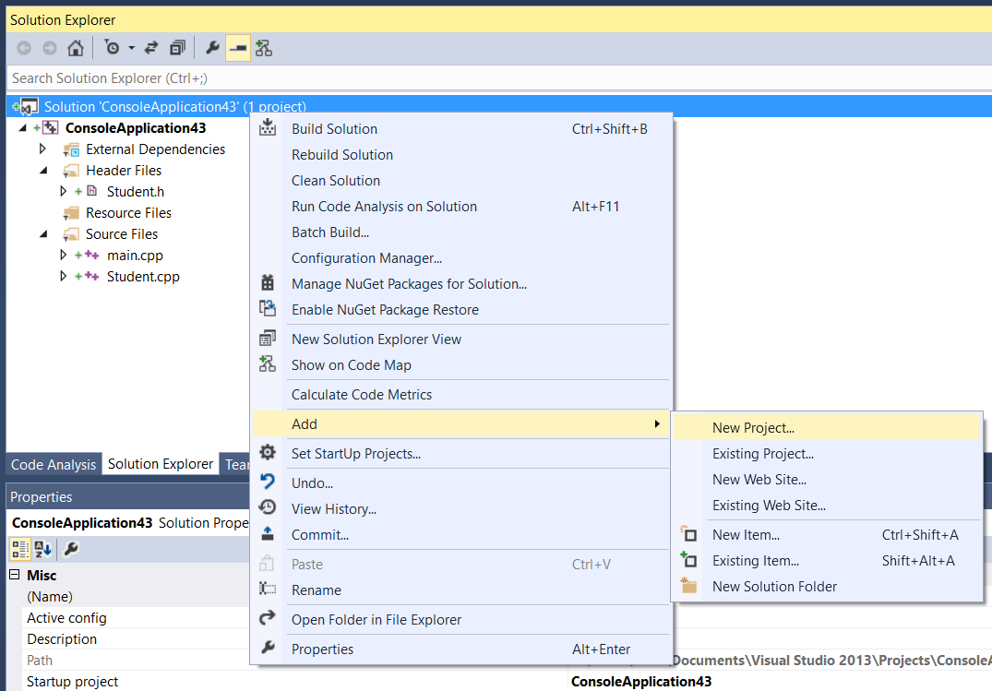
Adding another Project to a Solution
Right Clicking your Solution → Add → New Project…

Slide 15
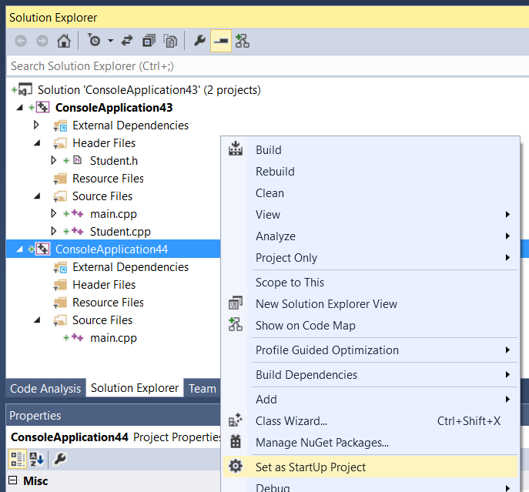
Switching between the Active Project
The Project in bold is your currently active project
Right Clicking your Project → Set as StartUp Project…

Slide 16
Suggested Solution and Project Naming for 205SE Homework
GitHub Repository Name:
<username>-Homework e.g.:
aa6164-Homework
Solution Name:
<username>-Homework e.g.:
aa6164-Homework
Project Name:
GradingProgram
ColaMachine
...
For Coursework use:
<username>-Coursework e.g.:
aa6164-Coursework

